Slide 1
Module 4 Attacks and Defenses
Section 3 – OS alteration attacks
June 2018

Slide 2
.
Section 1 – OS alteration attacks
Learning Objectives
Explain the attacks based on the alteration of the operating system
Securing OS boot process
SSDT Hooking

Slide 3
OS alteration attacks
Rely on malware execution to retrieve using different technics data or executing code.
Most of these malware are bootkits or rootkits
We will consider the OS boot processing and see how we can secure it.
We will spend time on SSDT Hooking

Slide 4
Securing OS boot process

Slide 5
Overview Securing OS Boot Process
When you run Windows 10 on a PC or any PC that supports Unified Extensible Firmware Interface (UEFI), Trusted Boot protects your PC from malware from the moment you power on your PC until your anti-malware starts.
In the unlikely event that malware does infect a PC, it can’t remain hidden
Trusted Boot can prove the system’s integrity to your infrastructure in a way that malware can’t disguise.
Even on PCs without UEFI, Windows 10 provides even better startup security than previous versions of Windows.

Slide 6
OS Boot Process - The threat: rootkits
Rootkits are a sophisticated and dangerous type of malware that run in kernel mode, using the same privileges as the operating system.
Because rootkits have the same rights as the operating system and start before it, they can completely hide themselves and other applications.
Often, rootkits are part of an entire suite of malware that can bypass local logins, record passwords and keystrokes, transfer private files, and capture cryptographic data.

Slide 7
OS Boot Process - The threat: rootkits
Different types of rootkits load during different phases of the startup process:
Firmware rootkits. These kits overwrite the firmware of the PC’s basic input/output system or other hardware so the rootkit can start before Windows.
Bootkits. These kits replace the operating system’s bootloader (the small piece of software that starts the operating system) so that the PC loads the bootkit before the operating system.
Kernel rootkits. These kits replace a portion of the operating system kernel so the rootkit can start automatically when the operating system loads.
Driver rootkits. These kits pretend to be one of the trusted drivers that Windows uses to communicate with the PC hardware.

Slide 8
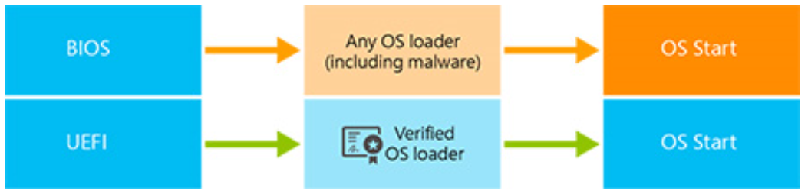
OS Boot Process - BIOS versus UEFI.
BIOS and UEFI startup processes differences.
Notes:
https://docs.microsoft.com/en-us/windows/security/information-protection/bitlocker/bitlocker-countermeasures

Slide 9
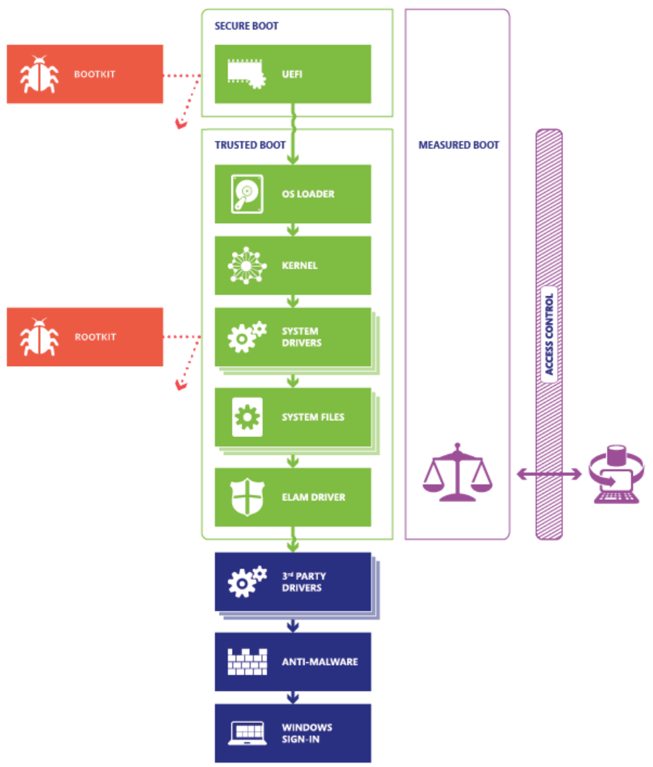
OS Boot Process - Windows 10 startup process.
Secure Boot, Trusted Boot, and Measured Boot block malware at every stage.
Notes:
https://docs.microsoft.com/en-us/windows/security/hardware-protection/secure-the-windows-10-boot-process

Slide 10
OS Boot Process - The threat: Countermeasures
Windows 10 supports four features to help prevent rootkits and bootkits from loading during the startup process:
Secure Boot. PCs with UEFI firmware and a Trusted Platform Module (TPM) can be configured to load only trusted operating system bootloaders.
Trusted Boot. Windows checks the integrity of every component of the startup process before loading it.
Early Launch Anti-Malware (ELAM). ELAM tests all drivers before they load and prevents unapproved drivers from loading.
Measured Boot. The PC’s firmware logs the boot process, and Windows can send it to a trusted server that can objectively assess the PC’s health.

Slide 11
OS Boot Process - Secure Boot
When a PC starts, it first finds the operating system bootloader.
PCs without Secure Boot simply run whatever bootloader is on the PC’s hard drive.
There’s no way for the PC to tell whether it’s a trusted operating system or a rootkit.

Slide 12
OS Boot Process - Secure Boot
When a PC equipped with UEFI starts:
The PC first verifies that the firmware is digitally signed, reducing the risk of firmware rootkits. If Secure Boot is enabled, the firmware examines the bootloader’s digital signature to verify that it hasn’t been modified. If the bootloader is intact, the firmware starts the bootloader only if one of the following conditions is true:
The bootloader was signed using a trusted certificate. In the case of PCs certified for Windows 10, the Microsoft® certificate is trusted.
The user has manually approved the bootloader’s digital signature. This allows the user to load non-Microsoft operating systems.

Slide 13
OS Boot Process - Secure Boot
All x86-based Certified For Windows 10 PCs must meet several requirements related to Secure Boot:
They must have Secure Boot enabled by default.
They must trust Microsoft’s certificate (and thus any bootloader Microsoft has signed).
They must allow the user to configure Secure Boot to trust other bootloaders.
They must allow the user to completely disable Secure Boot.

Slide 14
OS Boot Process - Secure Boot
Requirements to help protecting from rootkits while allowing you to run any operating system you want.
Use an operating system with a certified bootloader. Because all Certified For Windows 10 PCs must trust Microsoft’s certificate, Microsoft offers a service to analyze and sign any non-Microsoft bootloader so that it will be trusted by all Certified For Windows 10 PCs. In fact, an open source bootloader capable of loading Linux is already available. To begin the process of obtaining a certificate, go to http://sysdev.microsoft.com.
Configure UEFI to trust your custom bootloader. All Certified For Windows 10 PCs allow you to trust a non-certified bootloader by adding a signature to the UEFI database, allowing you to run any operating system, including homemade operating systems.

Slide 15
OS Boot Process - Secure Boot
Turn off Secure Boot. All Certified For Windows 10 PCs allow you to turn off Secure Boot so that you can run any software. This does not help protect you from bootkits, however.
video demonstration of Secure Boot

Slide 16
OS Boot Process - Secure Boot
To prevent malware from abusing these options, the user must manually configure the UEFI firmware to trust a non-certified bootloader or to turn off Secure Boot.
Software cannot change the Secure Boot settings.
For more information about Secure Boot, read the blog, Protecting the pre-OS environment with UEFI.
Like most mobile devices, ARM-based Certified For Windows RT devices, such as the Microsoft Surface RT device, are designed to run only Windows 8.1.
Therefore, Secure Boot cannot be turned off, and you cannot load a different operating system. Fortunately, there is a large market of ARM devices designed to run other operating systems.

Slide 17
OS Boot Process - Trusted Boot
Trusted Boot takes over where Secure Boot leaves off.
The bootloader verifies the digital signature of the Windows 10 kernel before loading it.
The Windows 10 kernel, in turn, verifies every other component of the Windows startup process, including the boot drivers, startup files, and ELAM.
If a file has been modified, the bootloader detects the problem and refuses to load the corrupted component.
Often, Windows 10 can automatically repair the corrupted component, restoring the integrity of Windows and allowing the PC to start normally.

Slide 18
OS Boot Process - Early Launch Anti-Malware
Because Secure Boot has protected the bootloader and Trusted Boot has protected the Windows kernel, the next opportunity for malware to start is by infecting a non-Microsoft boot driver.
Traditional anti-malware apps don’t start until after the boot drivers have been loaded, giving a rootkit disguised as a driver the opportunity to work.
Early Launch Anti-Malware (ELAM) can load a Microsoft or non-Microsoft anti-malware driver before all non-Microsoft boot drivers and applications, thus continuing the chain of trust established by Secure Boot and Trusted Boot. Because the operating system hasn’t started yet, and because Windows needs to boot as quickly as possible, ELAM has a simple task: examine every boot driver and determine whether it is on the list of trusted drivers. If it’s not trusted, Windows won’t load it.

Slide 19
OS Boot Process - Early Launch Anti-Malware
An ELAM driver isn’t a full-featured anti-malware solution; that loads later in the boot process.
Windows Defender (included with Windows 10) supports ELAM, as does Microsoft System Center 2012 Endpoint Protection and several non-Microsoft anti-malware apps.

Slide 20
OS Boot Process - Measured Boot
Enterprise anti-malware apps can report malware infections to the IT department, but that doesn’t work with rootkits that hide their presence.
As a result, PCs infected with rootkits appear to be healthy, even with anti-malware running. Infected PCs continue to connect to the enterprise network, giving the rootkit access to vast amounts of confidential data and potentially allowing the rootkit to spread across the internal network.
Working with the TPM and non-Microsoft software, Measured Boot in Windows 10 allows a trusted server on the network to verify the integrity of the Windows startup process. Measured Boot uses the following process:

Slide 21
OS Boot Process - Measured Boot
The PC’s UEFI firmware stores in the TPM a hash of the firmware, bootloader, boot drivers, and everything that will be loaded before the anti-malware app.
At the end of the startup process, Windows starts the non-Microsoft remote attestation client. The trusted attestation server sends the client a unique key.
The TPM uses the unique key to digitally sign the log recorded by the UEFI.
The client sends the log to the server, possibly with other security information.
Depending on the implementation and configuration, the server can now determine whether the client is healthy and grant the client access to either a limited quarantine network or to the full network.

Slide 22
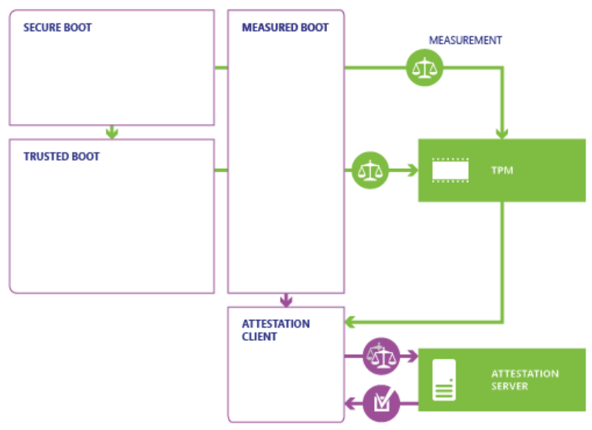
OS Boot Process – Measured Boot
Measured Boot proves the PC’s health to a remote server
Notes:
https://docs.microsoft.com/en-us/windows/security/hardware-protection/secure-the-windows-10-boot-process

Slide 23
SSDT Hooking

Slide 24
SSDT Hooking
The System Service Dispatch Table is a table containing pointers to service functions (APIs) in ntoskrnl.exe (NtOpenProcess, NtOpenThread, … ).
Make of a hook in this table consist to
Replace the original pointer value of an entry (let’s take NtOpenProcess for the example) by the address of a function with the same prototype in any kernel mode loaded module.
Usually, detouring an API is only made to filter the input parameters (and deny access if needed) and return the original pointer value at the end of the processing, to call the original function.

Slide 25
SSDT Hooking
Any loaded module can then detour the execution flow of an API to filter any attempt to open a handle on a process (in our example). This is very important, because a handle with enough rights is needed to kill a process with NtTerminateProcess. If we deny the call to NtOpenProcess, no program will be able to kill a given process (in theory…).
SSDT hooks are used by malware to self-protect, and by antivirus vendors (on old systems) to filter system access (process starts, registry write, …).

Slide 26
SSDT Hooking
Intel Processor Trace (Intel PT), specifically at the level where Intel PT communicates to Windows, “provides low overhead hardware that executes tracing on each hardware thread using dedicated hardware” and can be used for various legitimate purposes, including performance monitoring, diagnostic code coverage, debugging, fuzzing, and more.
However, it can also be abused for PatchGuard bypass.

Slide 27
SSDT mitigations
1
Ensure you rely on full memory encryption this implies there is proactive update monitoring to identify, test and deploy quickly these updates.
2
Use Advanced encryption modes like BitLocker.
3
Configure Power management and CMOS options
4
Rely on TCG-compliant Systems and provide Physical prevention (access to the machine itself)

Slide 28
SSDT links
SSDT :
https://resources.infosecinstitute.com/hooking-system-service-dispatch-table-ssdt/
https://www.adlice.com/kernelmode-rootkits-part-1-ssdt-hooks/
https://docs.microsoft.com/en-us/sysinternals/downloads/rootkit-revealer
https://bsodtutorials.wordpress.com/2014/01/08/shadow-ssdt-hooking-with-windbg/comment-page-1/
http://www.matousec.com/info/articles/plague-in-security-software-drivers.php
https://www.codeproject.com/Articles/1191465/The-Quest-for-the-SSDTs

